Slide 1

GALGOTIAS UNIVERSITY
NAME – Varsha singh

Slide 2
Hypothesis Testing
Hypothesis testing helps us decide about a population using sample data.
• Null Hypothesis (H₀): No effect
• Alternative Hypothesis (H₁): Effect exists
• Use sample data to calculate statistics and p-value
• A small p-value (e.g., < 0.05) means strong evidence against H₀

Slide 3
Why Hypothesis is Important ?
• Helps make decisions based on data
• Lowers the chance of making wrong conclusions
• Used in many fields like healthcare, business, and education
Example: COVID-19 study showed masks reduce infection rates (p < 0.01), leading to mandates.

Slide 4

Applications Across Fields
• Healthcare: Test if drugs work
• Business: Improve marketing
• Education: Compare teaching methods
• Environment: Track climate change
• Technology: Test new software features
Example: Pfizer’s vaccine showed 95%
effectiveness (p < 0.001)

Slide 5
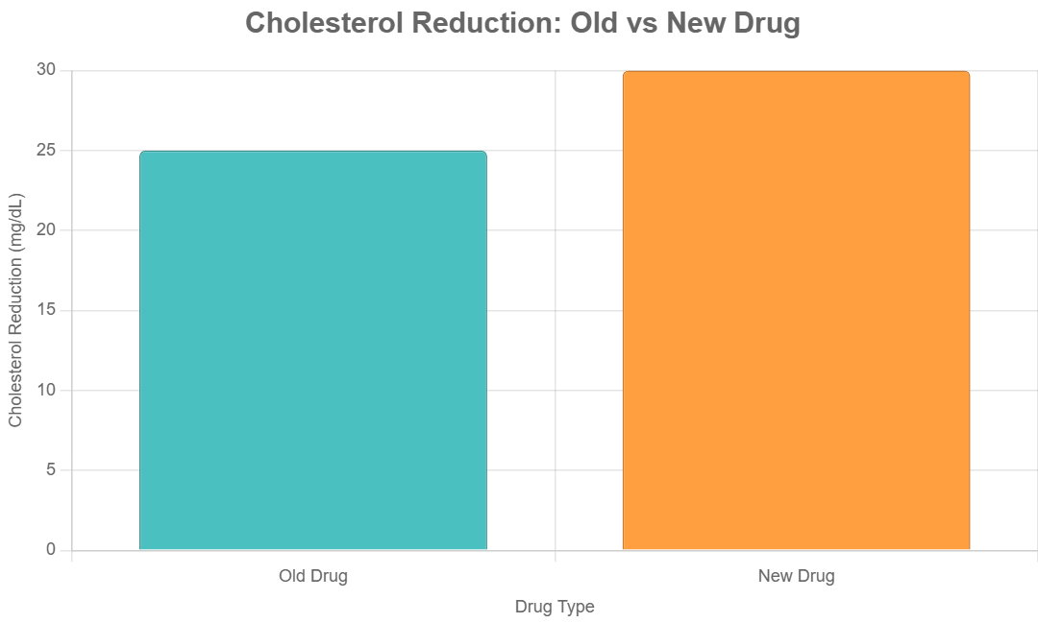
Case Study
Goal: Compare a new cholesterol drug to an old one
• H₀: Both drugs work the same
• H₁: New drug works better
• Test on 200 patients
• Results: New = 30 mg/dL, Old = 25 mg/dL
• P-value = 0.02 → Reject H₀

Slide 6
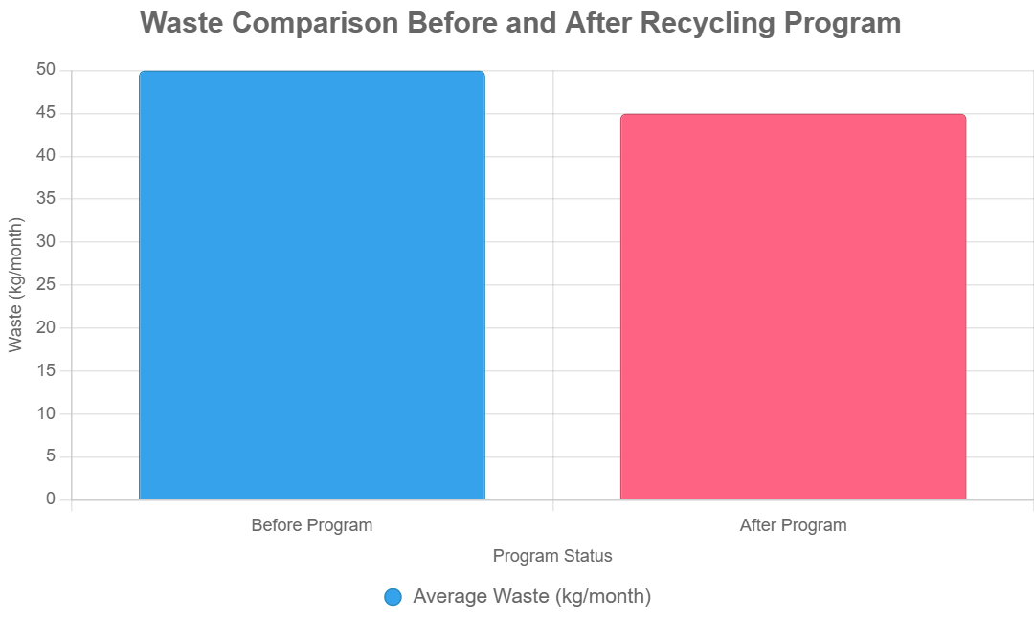
Case Study
Goal: See if a recycling program reduced waste
• H₀: No change in waste
• H₁: Less waste after program
• Data from 300 homes, before and after
• Before = 50 kg/month, After = 45 kg/month
• P-value = 0.004 → Reject H₀

